Slide 1

Cluster Computing
Present By: Bom bahadur BK
Level: Master
Nepal College of information Technology(NCIT)
Balkumari, lalitpur

Slide 2
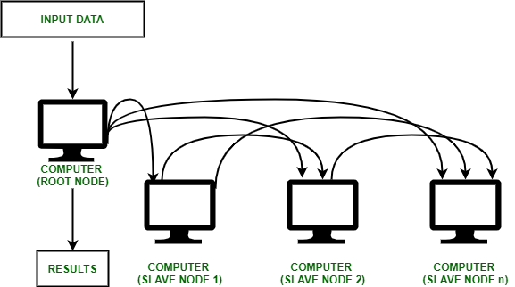
What is Clustering?
Cluster computing is a collection of tightly or loosely connected computers that work together so that they act as a single entity.
The connected computers execute operations all together thus creating the idea of a single system.
The clusters are generally connected through fast local area networks (LANs).

Slide 3
Key Components:
Cluster Nodes
Cluster Operating System
The switch or node interconnect
Network switching hardware
Purpose of cluster computing:
Improve performance
Ensure high availability
Provide fault tolerance

Slide 4
Classification of Cluster :
1. Open Cluster :
IPs are needed by every node and those are accessed only through the internet or web. This type of cluster causes enhanced security concerns.
2. Close Cluster :
The nodes are hidden behind the gateway node, and they provide increased protection. They need fewer IP addresses and are good for computational tasks.

Slide 5
Why is Cluster Computing important?
Cluster computing gives a relatively inexpensive, unconventional to the large server or mainframe computer solutions.
It resolves the demand for content criticality and process services in a faster way.
Many organizations and IT companies are implementing cluster computing to augment their scalability, availability, processing speed and resource management at economic prices.
It ensures that computational power is always available.
It provides a single general strategy for the implementation and application of parallel high-performance systems independent of certain hardware vendors and their product decisions.

Slide 6
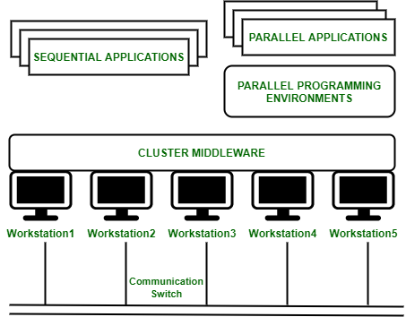
Cluster Computing Architecture
It is designed with an array of interconnected individual computers and the computer systems operating collectively as a single standalone system.
It is a group of workstations or computers working together as a single, integrated computing resource connected via high speed interconnects.
A node – Either a single or a multiprocessor network having memory, input and output functions and an operating system.
Two or more nodes are connected on a single line or every node might be connected individually through a LAN connection.

Slide 7
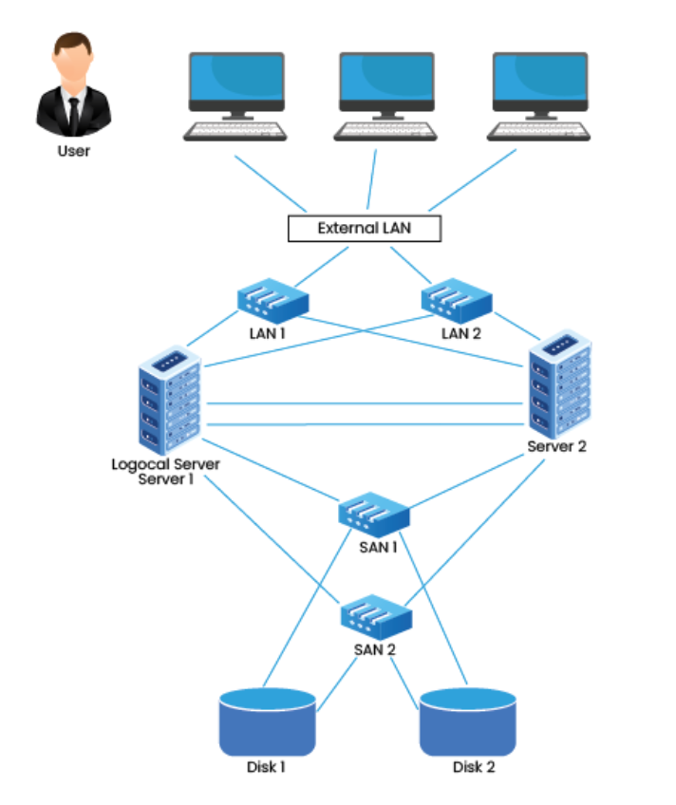
Types of Clustering:
1. High Availability (HA) and Failover Clusters
These cluster models create availability of services and resources in an uninterrupted method using the system’s implicit redundancy.
These types of Clusters serve as the base for critical missions, mails, files, and application servers.

Slide 8
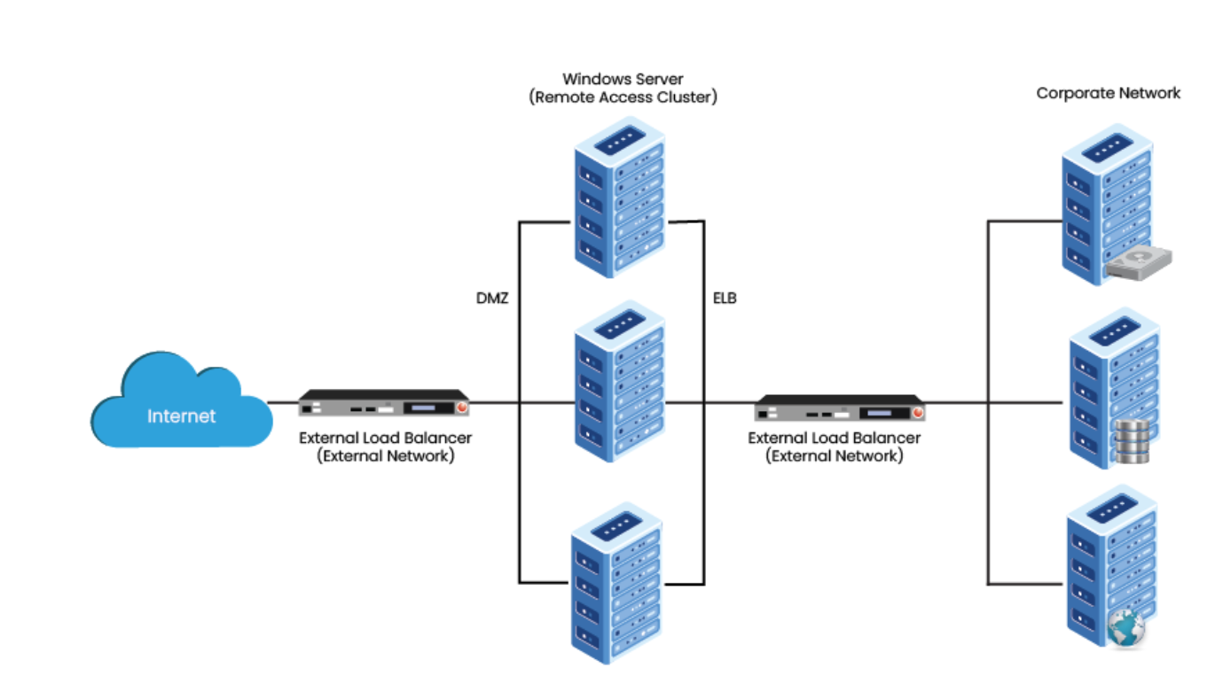
Types of Clustering:
2. Load Balancing Clusters
This Cluster distributes all the incoming traffic/requests for resources from nodes that run the same programs and machines.
Such a solution is usually used on web server farms.

Slide 9
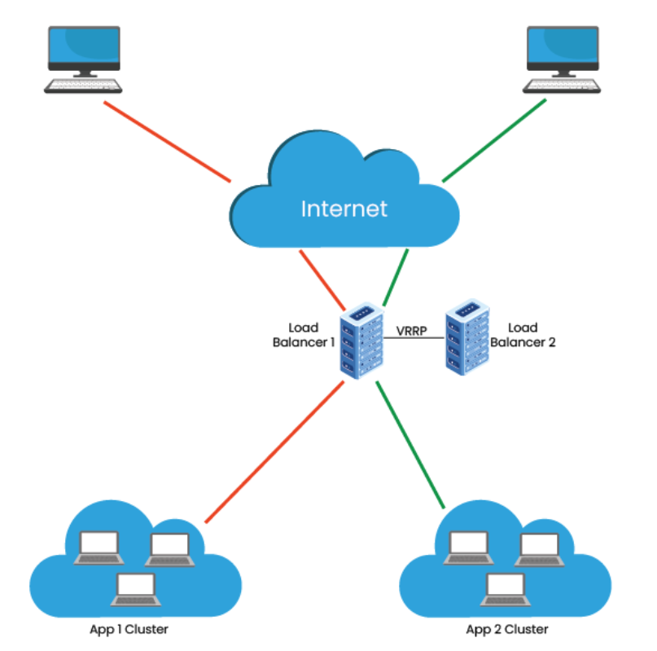
Types of Clustering:
3. HA & Load Balancing Clusters
This cluster model combines both clusters’ features, resulting in increased availability and scalability of services and resources.
This type of Clusters is commonly used for email, web, news, and FTP servers.

Slide 10
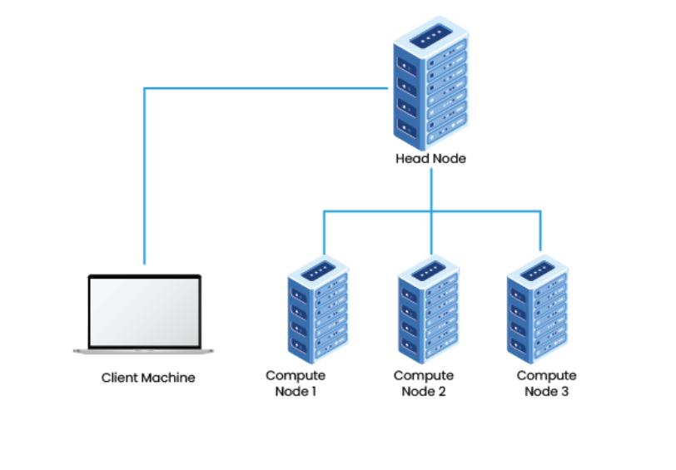
Types of Clustering:
4. Distributed & Parallel Processing Clusters
This Cluster model enhances availability and performance for applications that have large computational tasks. A large computational task gets divided into smaller tasks and distributed across the stations.
Such Clusters are usually used for scientific computing or financial analysis that require high processing power.

Slide 11
Advantages of Clustering
High Availability:
Ensures continuous operation even if one node fails.
Scalability:
Easily add more nodes to handle increased workloads.
Fault Tolerance:
Reduces the risk of system failure.
Improved Performance:
Distributes workloads across multiple nodes for faster processing.
Cost-Effective:
Utilizes existing hardware efficiently.

Slide 12
Disadvantages of Clustering
Complexity:
Setting up and managing clusters requires advanced technical knowledge.
Cost:
Initial setup and maintenance can be expensive.
Resource Intensive:
Requires additional hardware and software resources.
Single Point of Failure (SPOF):
If the cluster management software fails, the entire system may go down.
Compatibility Issues:
Not all applications are designed to work in a clustered environment.

Slide 13
Applications of Clustering
Web Servers: Load balancing for high-traffic websites.
Databases: Distributed databases for faster query processing.
Scientific Computing: Parallel processing for complex simulations.
Cloud Computing: Resource pooling and scalability in cloud environments.
Artificial Intelligence and Machine Learning: Training complex models using distributed computing.
Financial Modeling: Risk analysis and algorithmic trading.

Slide 14

Any Queries?

Slide 15
Thank You So Much!
Have a great time…

